Slide 1
How to reference when writing code

Slide 2
Introduction
The purpose of this guide to help you reference in your assignments when you use computer code.
This is very important as failing to reference correctly could potentially lead to a case of academic misconduct/breach of academic integrity.

Slide 3
Third Party Code
Code you take from a website, video, book or any other source must be referenced correctly by use of an in-text citation and a full reference in the reference section of your report.

Slide 4
Example
Let’s say your assignment involves validating input. In our example only “Yes and “No” values are allowed, and any other value entered causes the program to loop indefinitely.
You’ve researched how to do this using the internet and you’ve found some code that looks like it will work.
Are you allowed to use this code in your assignment?

Slide 5
Example cont…
Answer “Yes” but only if you adhere to the following requirements:
Code must be referenced using both an in-text citation and a full reference (more on this later).
Code must respect functional decomposition – in other words the code must perform a specific task and nothing else. This will “normally” result in referenced code being relatively short as large chunks of code is likely not functionally decomposed.

Slide 6
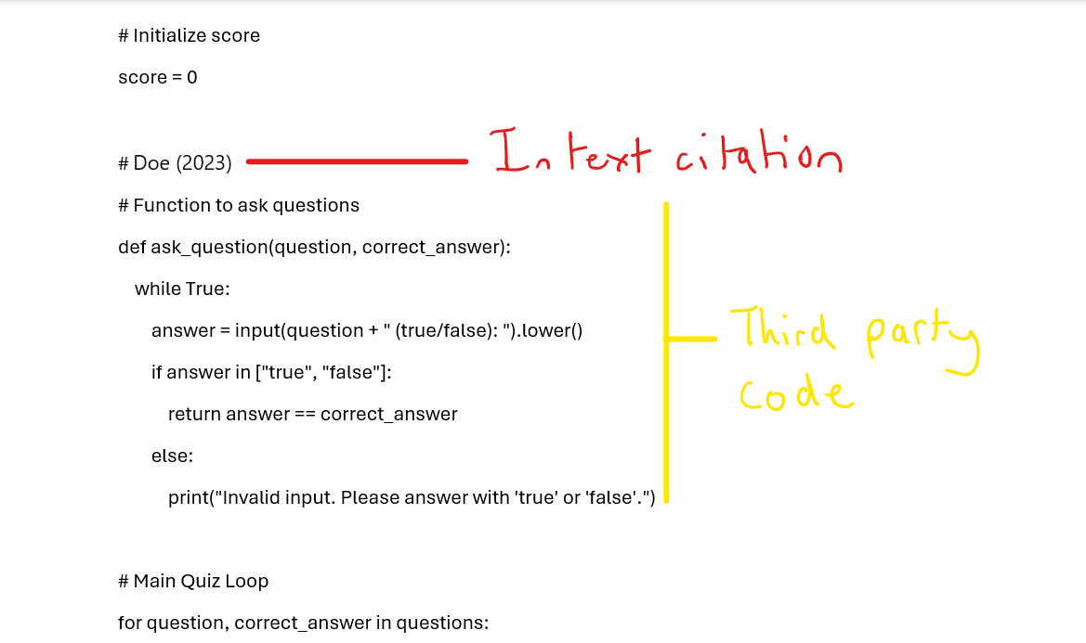
Example in-text citation for third-party code
This goes in the source code section of your written report, and you must highlight the 3rd party code.

Slide 7
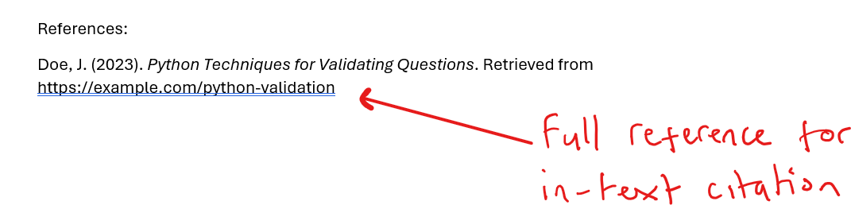
Example of full reference
This goes in the reference section of your report.

Slide 8
Modified Code
Code that has been found online but has been modified also needs to be referenced.
Think of this like paraphrasing - You are altering the code, but the meaning remains the same.
Modified code should be highlighted in your written report to show the changes made to it.
Modified code requires both an in-text citation and a full reference.

Slide 9
Example cont.
Let's say you’ve been asked to create a hangman game and you need a function that calculates the win/loss ratio for the user.
You’ve found a source, but the code does not do exactly what you need it to do so you modify it to work with your given scenario.
Again, you are allowed to do this so long as you:
Provide both an in-text citation and full reference
In your written report highlight code that has been modified
Adhere to the concept of functional decomposition

Slide 10
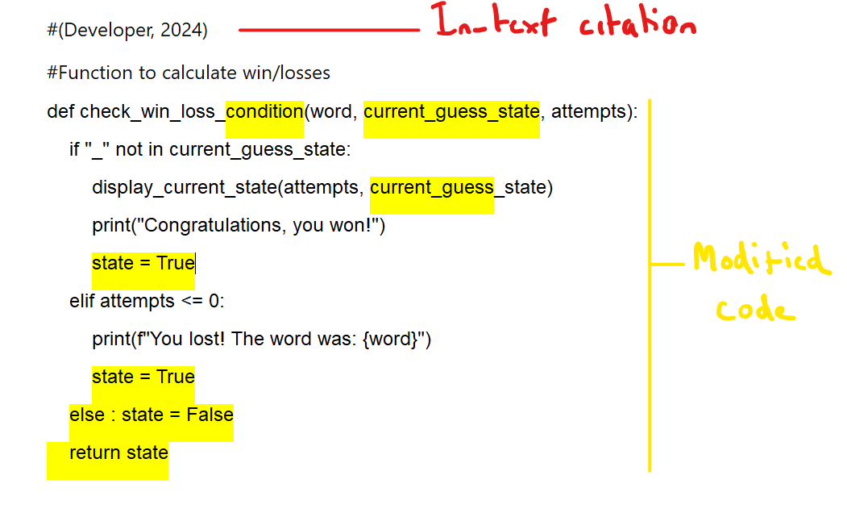
Example in-text citation for modified code
This goes in the source code section of your written report.

Slide 11
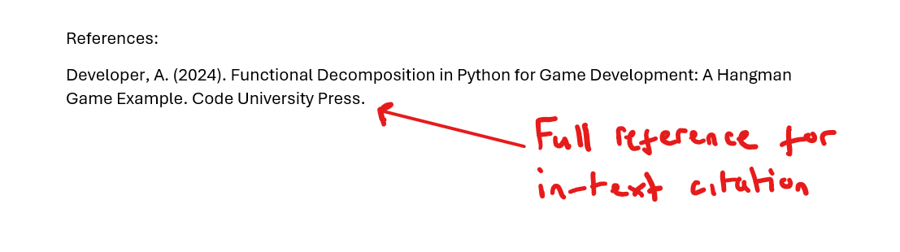
Example of full reference
This goes in the reference section of your written report.

Slide 12
AI – Generated Code
As a general rule code used in an assignment that has been generated by AI tools such as chat GPT should be avoided because:
Code can be wrong
Code introduces bad programming practises
Code introduces syntax/style not covered by course and therefore may not be assessed
Code produced is not indicative of student capabilities

Slide 13
AI Generated Code
If you use AI generated code as is – in other words no modifications have been made, then follow the guidelines for Third-party code use:
Provide both an in-text citation and full reference
In the written report highlight code that has been AI Generated
Adhere to functional decomposition
You also need to do the following:
Include the prompt you typed in, in the full reference of your report

Slide 14
Example
Let’s say you’ve been asked to create a program in python and one of the requirements is that it reads student data from a CSV file and parses it to ensure it is in the correct format.
You have looked online and read through some books but still can’t find a solution that will help so you decide to use generative AI to help.
Use of generative AI should be limited but if you do use it remember you need to:
Provide both an in-text citation and full reference
Adhere to the concept of functional decomposition
Include a reference to the prompt you entered that generated the code in the reference section

Slide 15
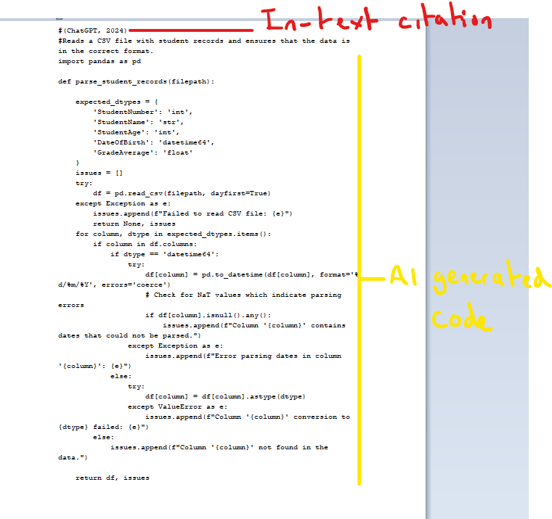
Example in-text citation for AI Generated Code
This goes in the source code section of your written report

Slide 16
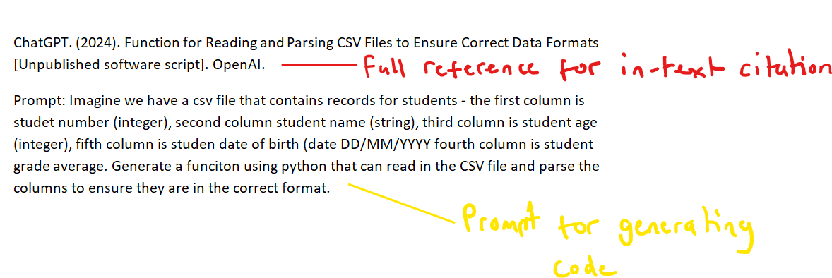
Example of full reference
This goes in the reference section of your report.

Slide 17
AI Generated Modified Code
If you use AI generated code but make modifications to it, then you need to follow the rules for modified code:
Provide both an in-text citation and full reference
In the written report highlight code that has been modified
Adhere to the concept of functional decomposition
You also need to do the following:
Include the prompt you typed in, in the full reference of your report

Slide 18
Example
Let's say we have been tasked with creating a wordsearch like game and we need a function to fill the grid with random letters.
You’ve researched online and looked through books but cannot finding anything that helps so you use generate AI to help.
Use of generative AI should be limited but if you do use it remember you need to:
Provide both an in-text citation and full reference
Adhere to the concept of functional decomposition
Include a reference to the prompt you entered that generated the code in the reference section

Slide 19
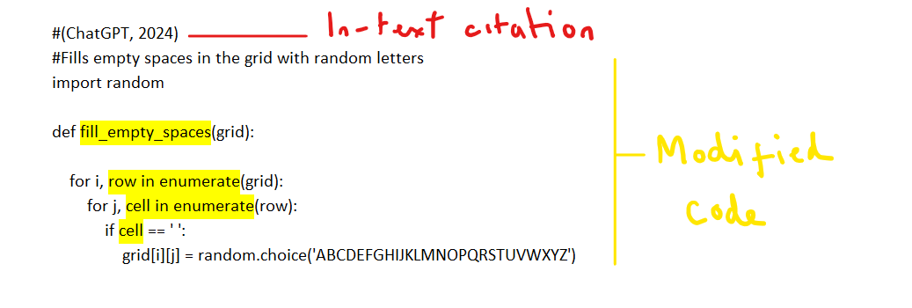
Example of in-text citation for AI generated modified code
This goes in the source code section of your written report.

Slide 20
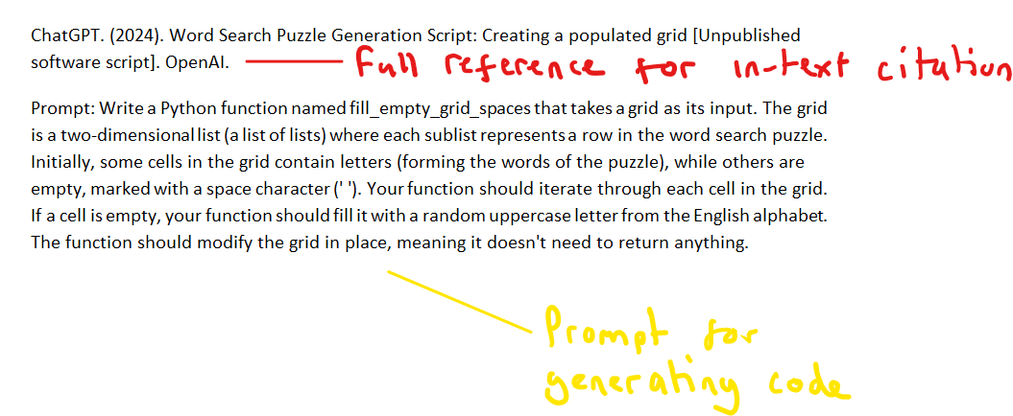
Example of full reference
This goes in the reference section of your written report.

